Slide 1
TOWNSHIP HIGH SCHOOL DISTRICT 113
Adult Education Newsletter
May 2023
Let’s Plan For The Next School Year!
Starting in July 2023 you may choose from the following Classes!
FREE
ALL
Levels of English
Language
Classes
All levels of English Language Classes!
Including conversation & pronunciation,
grammar, and writing!
Advanced Level
Citizenship Classes!
GED Preparation Classes!
Book Clubs!
Classes will be In-Person, Online and
Combined!

Slide 3
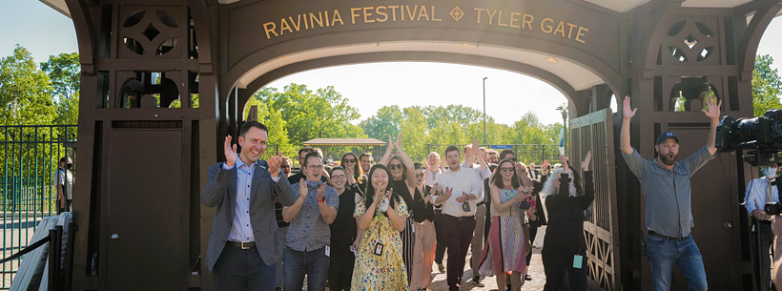
Available Job In Lake County, Illinois
Construction, Manufacturing, Transportation, Distribution & Logistics Jobs | Lake County, IL (lakecountyil.gov)
Hospitality, Retail & Food Service Jobs | Lake County, IL (lakecountyil.gov)
Healthcare, Information Technology & Professional Service Jobs | Lake County, IL (lakecountyil.gov)
Other Industry Jobs | Lake County, IL (lakecountyil.gov)
Government Agency Jobs | Lake County, IL (lakecountyil.gov)
Education Jobs | Lake County, IL (lakecountyil.gov)
Ravinia Festival | Official Site | Employment
Positions: * Operations * Education
* Food + Beverage * Guest Services

Slide 4
Our accelerated training format is designed to help students transition from the classroom into careers. IT Career Lab blends classroom instruction, online coursework and live practicum in a state-of-the-art lab as part of its pioneering instructional approach.
IT Career Lab offers small class sizes, a direct link
to the job market and a personal laptop computer for students to keep.
At IT Career Lab, we help talented individuals build
long-term careers in the information technology industry.
Our career coaches and instructors support students from goal development
to goal achievement.
From job training to job placement. IT Career Lab offers it all in one package.
Students receive our nationally - recognized Job Readiness Training and connections to hiring opportunities
Our students don’t just receive technology training – they experience it. In the classroom, online and in our state-of-the-art lab, students build skills and professional qualifications through our blended approach.

Slide 5
MICROSOFT 365: MODERN DESKTOP ADMINISTRATOR ASSOCIATE (MDAA)
IT INFRASTRUCTURE
LIBRARY FOUNDATION LEVEL CERTIFICATION (ITIL 4)
ABOUT
ABOUT
The Microsoft 365 Modern Desktop Administrator Associate (MDAA) certification validates the understanding of technology challenges in an enterprise level organization and the ability to provide solutions for desktop and device management for Windows 10 and non-Windows technologies. MDAA professionals are able to deploy, configure, secure, manage, and monitor devices and client applications in an enterprise environment.
The ITIL certification is a globally recognized IT service management certification. ITIL 4 Foundation enables candidates to look at IT service management through an end-to-end operation model for the creation, delivery, and continual improvement of tech-enabled products
OCUPPATIONS
Help Desk Technician
Help Desk Manager
Technology Analyst
OCUPPATIONS
Systems Administrator
Desktop Administrator
Network Operations Analyst
Technical Support Specialist
Network Technician
CISCO CERTIFIED
NETWORK ASSOCIATE (CCNA)
ABOUT
The Cisco Certified Network Associate (CCNA)
Certification program helps network engineers maximize investment in foundational networking knowledge and increase the value of your employer’s network.
OCUPPATIONS
Network Technician
Network Operations Engineer
Support Engineer
Systems Engineer

Slide 6
MICROSOFT OFFICE SPECIALIST IN MICROSOFT EXCEL
MICROSOFT OFFICE SPECIALIST ACCESS CERTIFICATION
ABOUT
ABOUT
The Microsoft Specialist in Microsoft Excel certification validates that students have a fundamental understanding of Excel and the skills to successfully perform operations with formulas and functions, in addition to managing data.
The Microsoft Office Specialist Access certification compliments the knowledge students earn within the data analytics training program. The certification itself validates ability to create custom, browser-based database applications including tasks such as query, form, and report creation
MICROSOFT CERTIFIED
DATA ANALYST ASSOCIATE
DATA ANALYTICS
OCCUPATIONS
ABOUT
Database Analyst
Business Analyst
Associate Project Manager
And more!
The Data Analyst Associate certification validates the ability to create and optimize data visualization techniques. It ensures that students: creatively engage with data, configure dashboards, implement artificial intelligence methods when appropriate, and more.
Contact us at or visit us at
IT Career Lab: Today’s Technology. Your Future.
At IT Career Lab, professionals move at the speed of technology using a unique accelerated approach that offers a globally-recognized multi-certification curriculum with hands-on training on a live network. As a Cisco Networking Academy and Certified Microsoft Partner, IT Career Lab is always on the cutting edge, with the most current offerings for career pathways in information technology careers. Our certified instructors offer working-world scenarios inside the classroom, optimizing preparation for the work environment. At IT Career Lab, we have never cancelled or rescheduled new class start dates and we remain steadfast in our commitment to building our future information technology workforce.
IT Career Lab – 567 W. Lake Street, Suite 1150 – Chicago, IL 60661
ITCareerLab.org - 312.994.4300
IT Career Lab is a division of National Able Network, Inc.
IT Career Lab, a division of National Able Network, is not accredited by a US Department of Higher Education recognized accrediting body. IT Career Lab is approved by the Division of Private Business and Vocational Schools of the Illinois Board of Higher Education and the Illinois State Approving Agency for the enrollment of qualified veterans and /for eligible persons to receive G.I. Bill educational benefits.
G.I. Bill is a registered trademark of the U.S. Department of Veterans Affairs (VA)

Slide 7
Link for Job information from the OneStop Resource Library for May: https://www.lakecountyil.gov/2811/Resource-Library.
Page 4
FULL CHICAGO EVENTS CALENDAR
April 2023 Events
May 2023 Events
June 2023 Events
July 2023 Events
Current Workshops
https://www.lakecountyil.gov/393/Calendars
Link for current workshops
*** For more information or if you have any questions, please contact one of the
District 113 Support Staff ***
Suzanne Klauke Transition Coordinator Phone: 224-765-2410 Email: sklauke@dist113.org | Diego Albarran Admin Assistant (English/Spanish) Phone:224-765-2410 Email: dalbarran@dist113.org | Veronica Albarran (English/Spanish) Support Services Coordinator Phone: 224-384-7288 Email: valbarran@dist113.org

